Slide 1

Leveraging predictability of
Deep Learning techniques on financial time series forecasting
GUIDE NAME: Prof. SARAT CHANDRA NAYAK
PROJECT GROUP: P10-15
SRI VAISHNAVI VASA HU21CSEN0100673
LEENA DEEKOLLU HU21CSEN0100741
BINDU SRI HU21CSEN0101184
GSoT, Computer Science & Engineering

Slide 2
CONTENTS
→OVERVIEW
→ABSTRACT
→PROBLEM STATEMENT
→MODELS
→ARIMA
→SARIMA
→EXPONENTIAL SMOOTHING
→PROPHET
→GARCH
→CNN
→RNN
→LSTM
→BI-LSTM
→GRU
→GNN
→RESNET
→TRANSFORMER
→DEEPAR
→TIMESNET
→TIMESNET+CNN 3D
→TIMESNET+ GRU
→TIMESNET+BI LSTM
→MODEL PERFORMANCE RESULTS
→PROPOSED MODEL
→CHALLENGES
GSoT, Computer Science & Engineering

Slide 3
ABSTRACT
Financial time series forecasting has become a vital focus within computational intelligence, engaging finance researchers in academia and industry alike due to its broad applications and substantial impact. While numerous Machine Learning (ML) models have been developed for this purpose, an extensive array of surveys already exists covering ML applications in financial forecasting.
More recently, Deep Learning (DL) models have entered the field, showing significant performance improvements over traditional ML methods. However, despite the growing interest in DL for financial time series forecasting, there is a notable lack of research focused specifically on DL applications for finance, particularly for region-specific data. This research aims to bridge this gap by experimenting with various DL models to optimize forecasting accuracy specifically for the Bombay Stock Exchange. Through this study, we seek not only to review current DL approaches but also to identify, improve, and potentially introduce a novel model tailored to Indian stock data. In addition to providing a comprehensive review, this research highlights potential setbacks and emerging opportunities in DL for financial forecasting, offering insights valuable to future researchers in the field.
GSoT, Computer Science & Engineering

Slide 4
PROBLEM STATEMENT
Financial time series forecasting faces significant challenges that can compromise the accuracy and reliability of predictions. Issues such as data quality, including missing values and gaps in historical records, pose considerable hurdles for forecasting models. Additionally, non-stationarity in financial data, often caused by structural breaks from market regulations or global events, complicates the modeling process. The inherent volatility and uncertainty of financial markets further necessitate advanced modeling techniques capable of capturing the complex, nonlinear relationships among variables, as traditional linear models may not adequately reflect the dynamics of these systems.
Despite the increasing interest in deep learning (DL) techniques, there is a notable lack of comprehensive literature reviews focusing on their implementation and effectiveness in financial time series forecasting. This research aims to fill this gap by systematically reviewing existing DL methodologies, highlighting their strengths and weaknesses, and evaluating their predictability in overcoming common challenges such as overfitting and model generalization. Furthermore, we will experiment with various DL models on financial datasets, specifically focusing on the Bombay Stock Exchange, to identify an optimized model for this context. By leveraging the predictive capabilities of DL, this study seeks to enhance forecasting accuracy, ultimately contributing to improved decision-making processes within the finance industry.
GSoT, Computer Science & Engineering

Slide 5
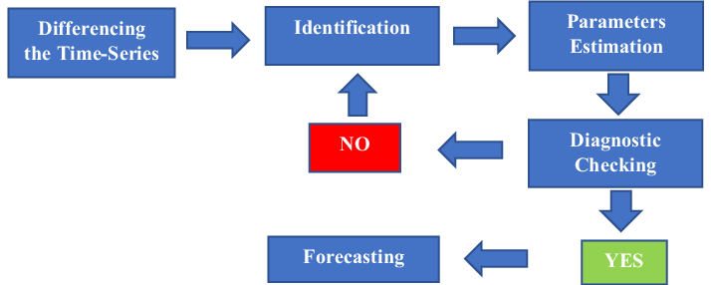
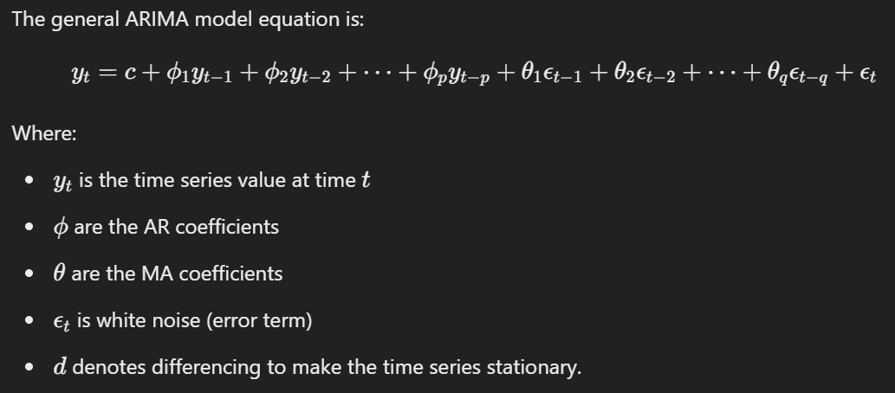
ARIMA (AUTOREGRESSIVE INTEGRATED MOVING AVERAGE)
ARIMA models are statistical tools used to analyze and predict time series data. They break down time series into three components:
Autoregression (AR): Uses past values of the series to predict future values.
Integration (I): Makes the series stationary by differencing.
Moving Average (MA): Uses past errors in the model to predict future values.
It is expressed as ARIMA(p,d,q) where;
p → order of autoregressive model
d → degree of differencing
q → order of the moving average model
Fig : Working/Architecture of the model
Fig : Equation of the model
GSoT, Computer Science & Engineering

Slide 6
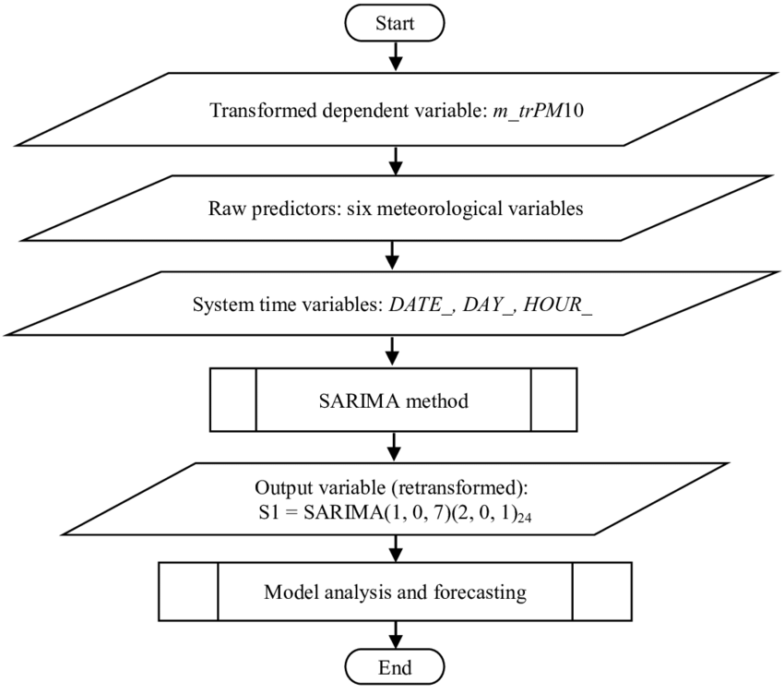
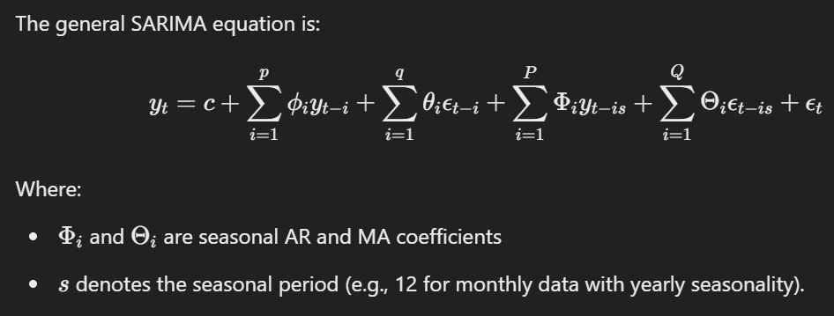
SARIMA (SEASONAL ARIMA)
SARIMA, which stands for Seasonal Autoregressive Integrated Moving Average, extends ARIMA by adding seasonal components to account for patterns that repeat over a fixed period (seasonality).
It is represented as SARIMA(p, d, q)(P, D, Q, s) where:
p,d,q are as in ARIMA
P,D,Q represent the seasonal part orders of AR, differencing, and MA is the length of the seasonal cycle
Fig : Working/Architecture of the model
Fig : Equation of the model
GSoT, Computer Science & Engineering

Slide 7
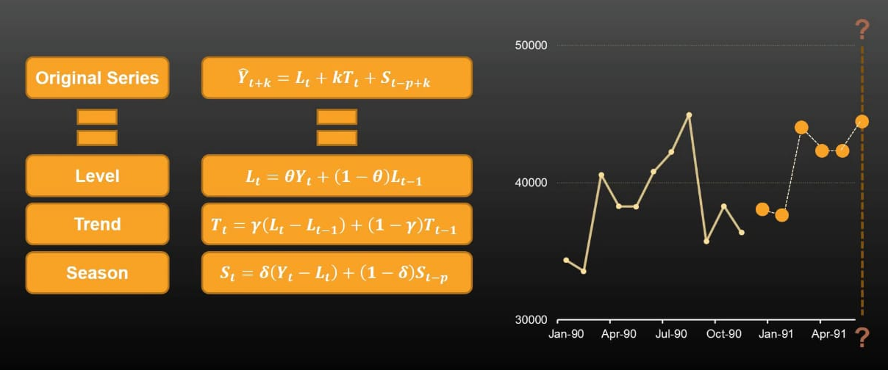
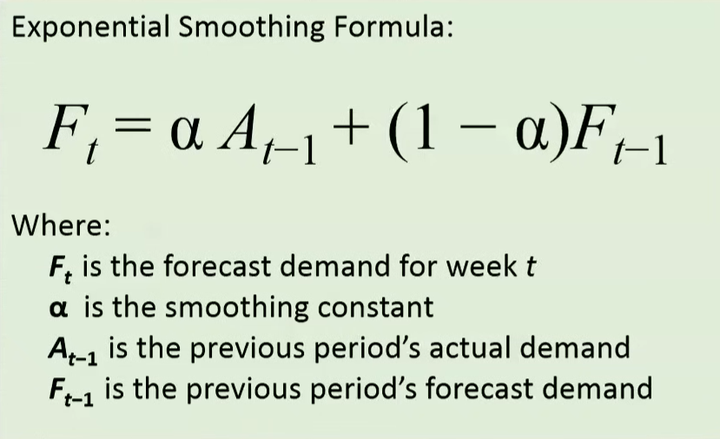
EXPONENTIAL SMOOTHING
Exponential Smoothing is a time-series forecasting technique that uses weighted averages of past observations, where weights decrease exponentially over time, to predict future values. It assumes that more recent data is more relevant for forecasting.
Architecture Highlights:
Weighted Averaging Framework: Assigns exponentially decreasing weights to past observations, ensuring recent data has a stronger influence on predictions while still accounting for older data.
Recursive Computation: Computes forecasts using a recursive equation, which simplifies the model and allows efficient updating as new data arrives.
Variants for Trend and Seasonality: Supports extensions like Holt’s Linear Trend Method for trend forecasting and Holt-Winters Method for handling seasonality, making it versatile for different time-series patterns.
Fig : Working/Architecture of the model
Fig : Equation of the model
GSoT, Computer Science & Engineering

Slide 8
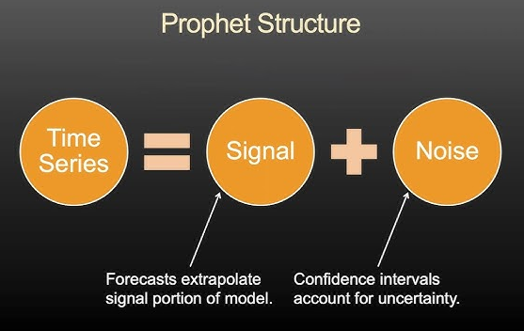
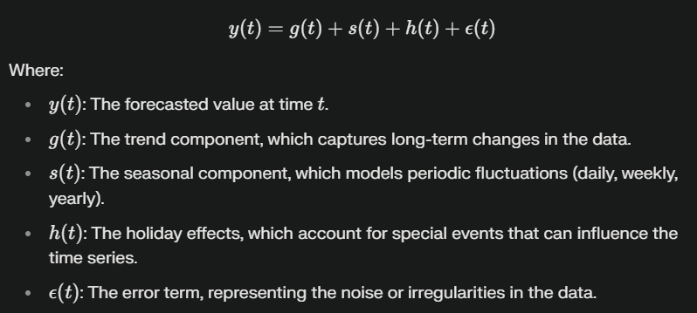
PROPHET
The Prophet model is a forecasting tool developed by Facebook for predicting time series data, particularly for business applications. It is designed to handle seasonality, holidays, and missing data with minimal preprocessing, making it user-friendly.
The architecture of Prophet is based on an additive model that decomposes the time series into three components: trend, seasonality, and holidays.
The trend is modeled using a piecewise linear or logistic growth curve
Seasonality is captured using Fourier series.
Holidays and special events can be incorporated as custom regressors, allowing the model to adjust for specific influences..
Fig : Working/Architecture of the model
Fig : Equation of the model
GSoT, Computer Science & Engineering

Slide 9
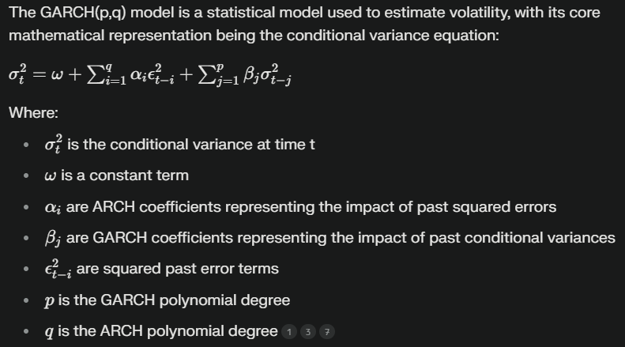
GARCH
The GARCH (Generalized Autoregressive Conditional Heteroskedasticity) model is widely used for modeling financial time series data with time-varying volatility. It captures the changing variance over time, which is crucial for modeling asset returns, volatility clustering, and financial market risks.
The architecture of GARCH includes following main components:
Autoregressive (AR) part: It models the dependence of past values on current volatility.
Moving Average (MA) part: It incorporates the past squared errors in forecasting the conditional variance.
Conditional: This informs that the variance is based on past errors.
Heteroskedasticity: This implies the series displays unusual variance (varying variance).
Fig : Equation of the model
GSoT, Computer Science & Engineering

Slide 10
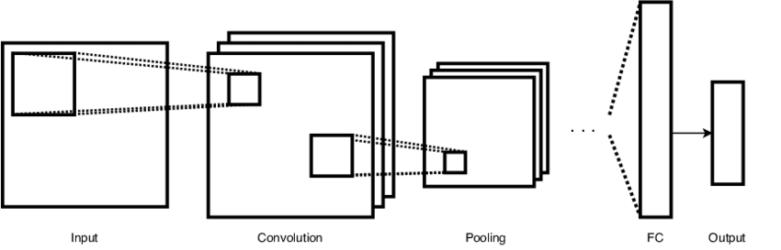

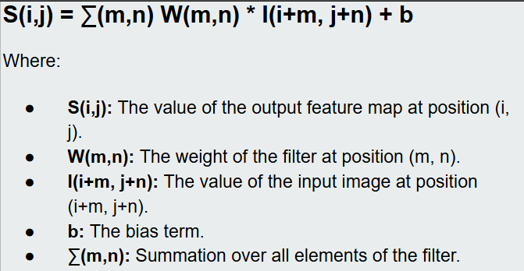
CNN (CONVOLUTIONAL NEURAL NETWORK)
Convolutional Neural Networks (CNNs), traditionally used for image processing, are also effective for time series forecasting by capturing local patterns and trends in the data through convolution operations.
Convolution Layers: CNNs use filters to slide over input data, identifying local patterns like trends or seasonality.
Pooling: Pooling layers (e.g., max-pooling) reduce dimensionality, preserving key features while minimizing noise.
Feature Learning: Stacked convolutional layers extract higher-level, abstract features from the time series.
Fully Connected Layer: Flattened features are fed into a fully connected layer for final prediction.
Non-Linearity: Activation functions like ReLU introduce non-linearity, helping the model learn complex patterns.
Fig : Working/Architecture of the model
Fig : Equation of the model
GSoT, Computer Science & Engineering

Slide 11
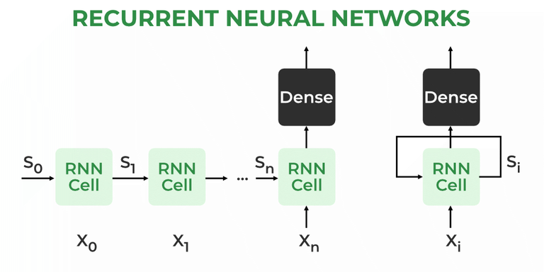
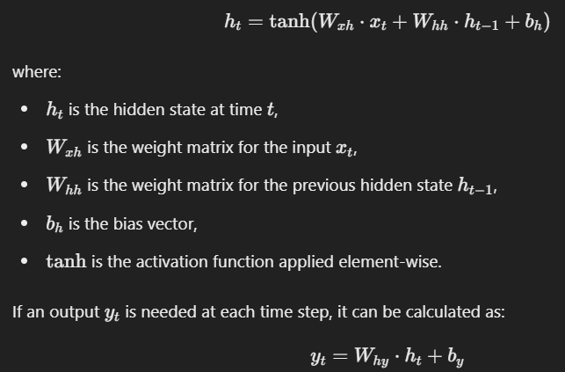
RNN (RECURRENT NEURAL NETWORK)
Recurrent Neural Networks (RNNs) are designed to handle sequential data, making them suitable for time series forecasting. They use feedback loops to process input sequences and maintain a hidden state that captures information from previous time steps.
Hidden State: RNNs maintain a hidden state hth_tht​ that updates at each time step ttt based on the current input xtx_txt​ and the previous hidden state ht−1h_{t-1}ht−1​.
Sequential Processing: The hidden state passes information from one time step to the next, capturing dependencies between the current and previous inputs.
Output: At each time step, the RNN produces an output yty_tyt​ based on the hidden state
Backpropagation Through Time (BPTT): During training, RNNs use BPTT to update weights by propagating errors backward through the sequence.
Fig : Working/Architecture of the model
Fig : Equation of the model
GSoT, Computer Science & Engineering

Slide 12
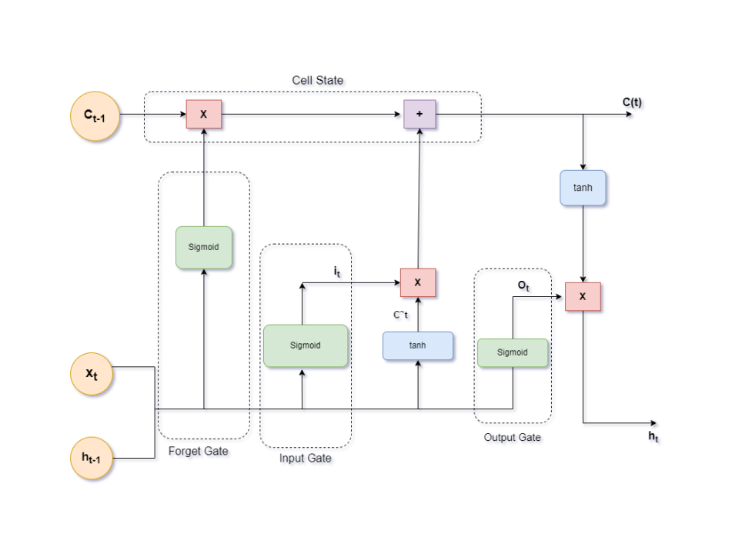
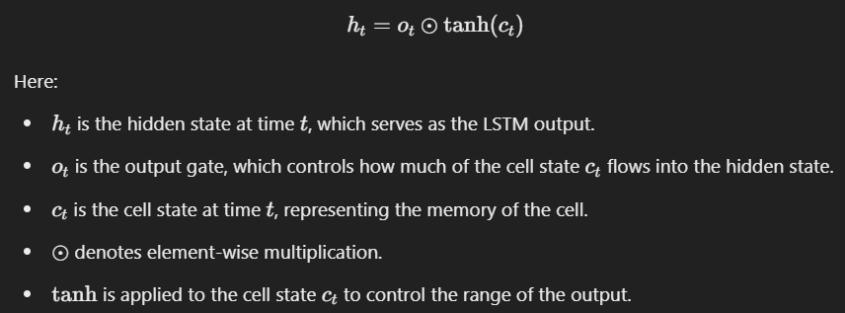
LSTM (LONG SHORT TERM MEMORY)
LSTM (Long Short-Term Memory) is a type of recurrent neural network (RNN) designed to capture long-term dependencies in sequential data, making it highly effective for time series forecasting.
Memory Cells: LSTM units contain memory cells that maintain information over time, which helps the model remember patterns in the time series data.
Gates: LSTM uses three gates to control the flow of information: Forget Gate, Input Gate, Output Gate
Cell State Update: The cell state is updated based on the forget and input gates. It allows LSTM to carry forward relevant information and discard irrelevant data.
Fig : Working/Architecture of the model
Fig : Equation of the model
GSoT, Computer Science & Engineering

Slide 13
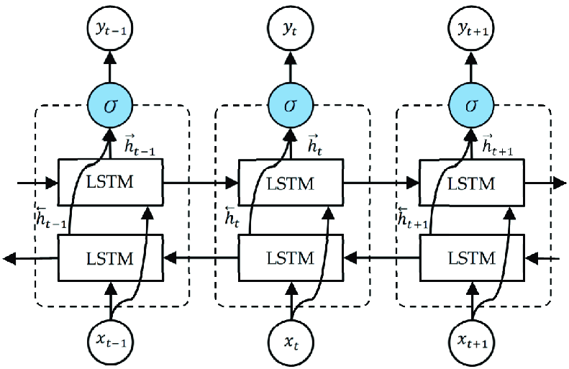
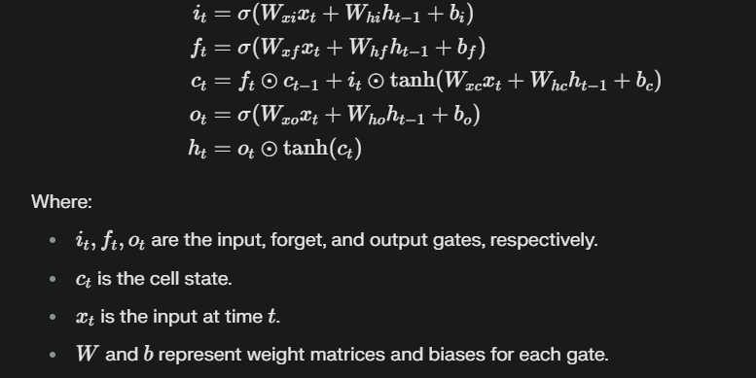
BI LSTM (BI-DIRECTIONAL LSTM)
Bi-LSTM (Bidirectional Long Short-Term Memory) is a recurrent neural network architecture that enhances traditional LSTM models by processing input sequences in both forward and backward directions which helps to capture both past and future context
Architecture Highlights:
Two LSTM Layers:
One processes the sequence from start to end (forward pass).
The other processes it from end to start (backward pass).
Concatenation of Outputs:
Outputs from the forward and backward layers are combined, providing a richer representation of the input data.
Memory Cells:
Uses memory cells and gating mechanisms (input, forget, and output gates) to manage long-term dependencies and mitigate issues like vanishing gradients.
Fig : Working/Architecture of the model
Fig : Equation of the model
GSoT, Computer Science & Engineering

Slide 14
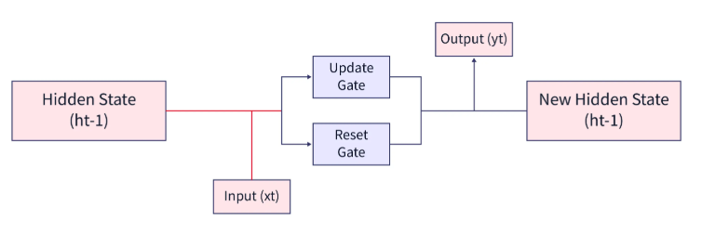
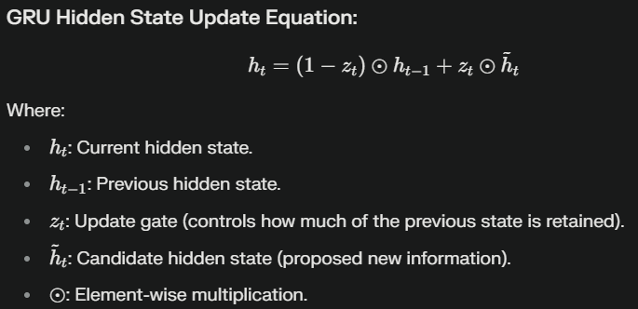
GRU (GATED RECCURENT UNIT)
GRU (Gated Recurrent Unit) is a type of recurrent neural network (RNN) architecture designed to efficiently capture temporal dependencies in sequential data while mitigating the vanishing gradient problem. It simplifies computation compared to LSTMs by reducing the number of gates.
Architecture Highlights:
Gating Mechanism: Combines reset and update gates to control the flow of information, determining how much of the past information to keep or discard at each step.
Compact Design: Fewer parameters than LSTM, as it merges the input and forget gates into a single update gate, making it computationally efficient while retaining performance.
Sequential Learning: Processes data step-by-step to learn temporal patterns, suitable for time-series forecasting, language modeling, and other sequential tasks.
Fig : Working/Architecture of the model
Fig : Equation of the model
GSoT, Computer Science & Engineering

Slide 15
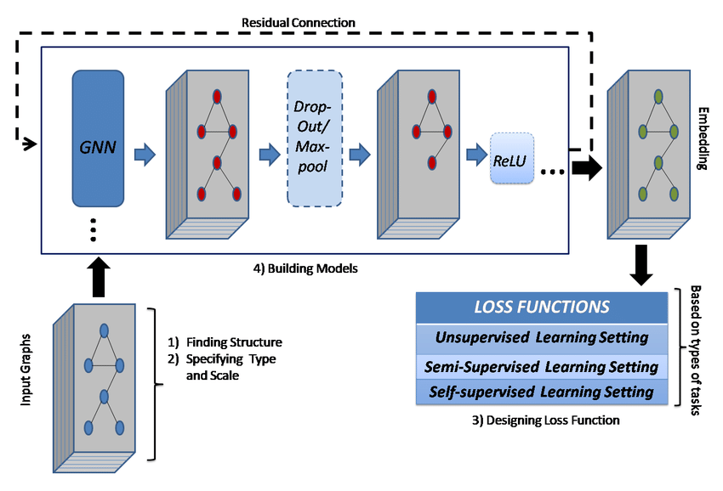
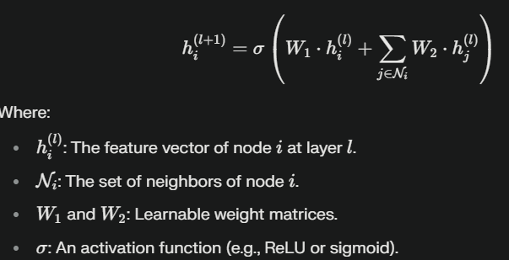
GNN (GRAPH NEURAL NETWORK)
Graph Neural Networks (GNNs) are deep learning models designed to process data represented as graphs, effectively capturing relationships and dependencies between entities (nodes) through their connections (edges).
Architecture Highlights:
Message Passing Framework: Nodes aggregate information from their neighbors through iterative message-passing steps, updating their embeddings to capture local and global graph structures.
Graph Convolution Layers: Utilizes layers like Graph Convolutional Networks (GCN), Graph Attention Networks (GAT), or GraphSAGE to compute node embeddings based on adjacency relationships and feature propagation.
Hierarchical Pooling: For graph-level tasks, hierarchical pooling methods (e.g., DiffPool) summarize graph structures into compact representations for downstream tasks.
Fig : Working/Architecture of the model
Fig : Equation of the model
GSoT, Computer Science & Engineering

Slide 16
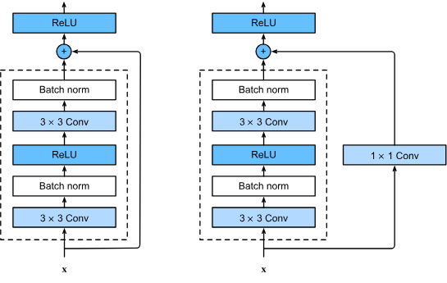
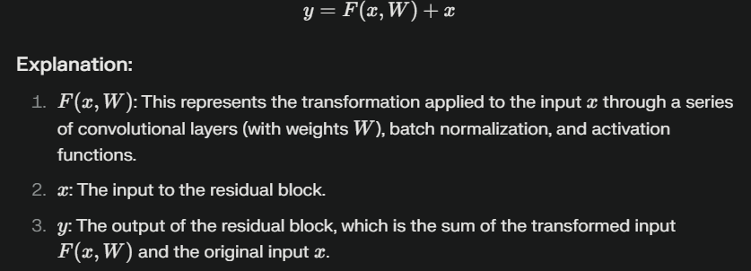
RESNET (RESIDUAL NETWORK)
ResNet (Residual Network) is a deep learning model designed to address the vanishing gradient problem in deep neural networks by introducing residual connections. It is widely used for image recognition, object detection, and other computer vision tasks.
Architecture Highlights:
Residual Blocks:
Each block includes shortcut connections that bypass one or more layers, directly adding the input to the output.
These connections help preserve information and make optimization easier.
Deep Stacking:
ResNet allows stacking hundreds or even thousands of layers while maintaining efficient training and high accuracy.
Convolutions:
Uses convolutional layers to extract spatial features, followed by batch normalization and activation functions like ReLU.
The residual connections enable training of very deep networks, significantly improving performance while mitigating gradient-related issues.
Fig : Working/Architecture of the model
Fig : Equation of the model
GSoT, Computer Science & Engineering

Slide 17

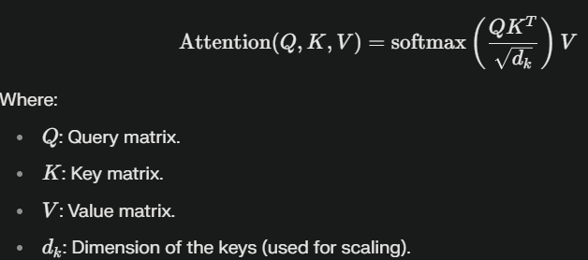
TRANSFORMER
The Transformer is a deep learning model that uses self-attention to capture relationships in sequential data, enabling parallel processing and scalability. It is widely used for tasks like language modeling and time-series analysis.
Architecture Highlights:
Self-Attention: Focuses on relevant input elements, capturing global dependencies.
Positional Encoding: Adds sequence order information to embeddings.
Multi-Head Attention: Extracts diverse patterns through multiple attention mechanisms.
Feedforward Layers: Refines features with fully connected layers.
Encoder-Decoder: Encodes input into context and decodes to generate output.
Fig : Working/Architecture of the model
Fig : Equation of the model
GSoT, Computer Science & Engineering

Slide 18
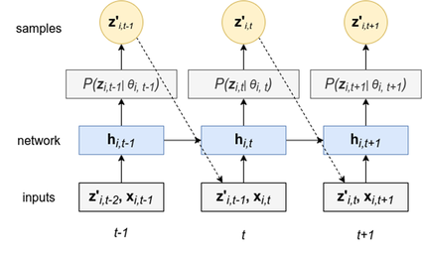
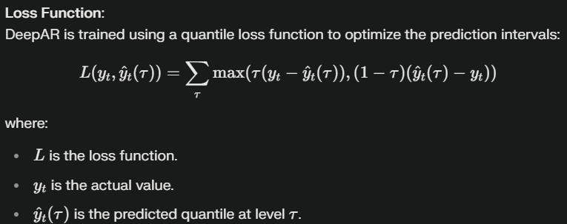
DEEPAR
DeepAR is a probabilistic forecasting model which leverages autoregressive recurrent neural networks (RNNs), specifically using LSTM or GRU units, to predict the probability distribution of future values based on historical data.
Architecture Highlights:
Autoregressive Framework:
Predicts the next time step conditioned on past observations and its own previous predictions, allowing sequential forecasting.
Recurrent Neural Networks (RNNs):
Uses LSTM or GRU layers to capture long-term dependencies and temporal patterns in the data.
Probabilistic Outputs:
Instead of point predictions, DeepAR models the distribution of future values (e.g., Gaussian or negative binomial), enabling uncertainty quantification.
Fig : Working/Architecture of the model
Fig : Equation of the model
GSoT, Computer Science & Engineering

Slide 19
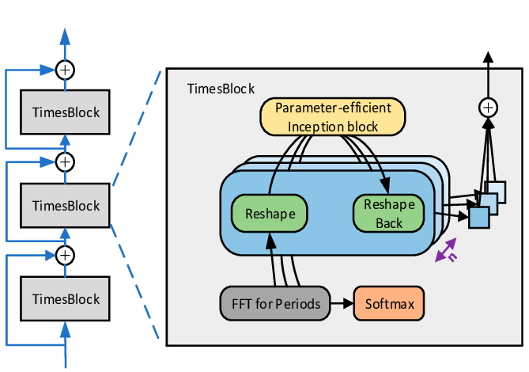
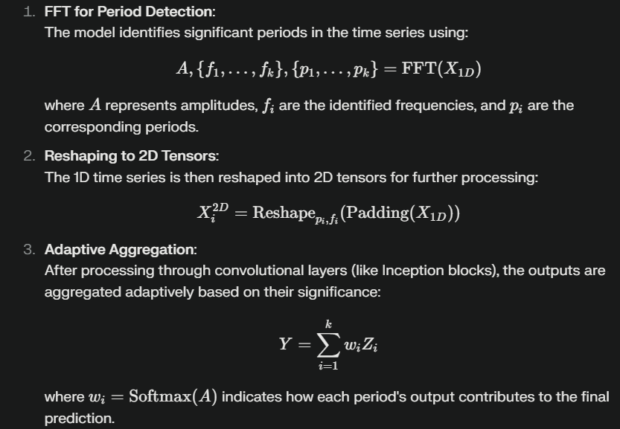
TIMESNET
TimesNet (Temporal Inception Multi-Period Embedding Network) leverages a combination of CNNs, which effectively handle 2D or multivariate data, and temporal variation analysis to identify complex patterns that other models might overlook.
The TimesBlock is the core component of TimesNet, designed to capture multi-periodicity and complex temporal variations.
It reshapes 1D time series into 2D tensors using FFT to identify periods, separating interperiod and intraperiod variations into rows and columns, respectively.
The architecture incorporates inception blocks, which efficiently process these 2D tensors to extract intricate patterns and enhance representation capability for diverse time-series tasks.
Fig : Working/Architecture of the model
Fig : Equation of the model
GSoT, Computer Science & Engineering

Slide 20
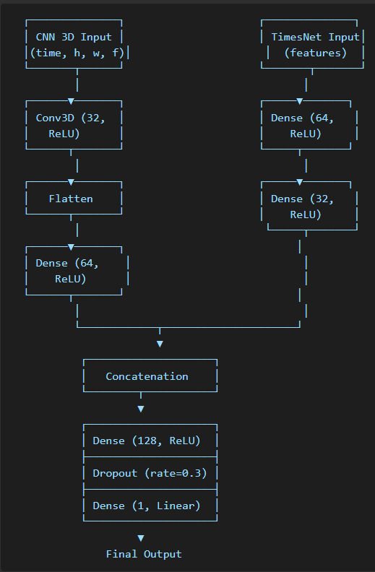
CNN 3D + TIMESNET
CNN 3D:
Extracts spatiotemporal patterns (e.g., trends and fluctuations over time) from the reshaped 3D input.
Focuses on capturing how features evolve over time.
TimesNet:
Learns feature-specific relationships and dependencies directly from the original data.
Focuses on capturing relationships between features at specific time points.
Integration:
The outputs of CNN 3D and TimesNet are merged, allowing the model to leverage both spatial-temporal dynamics and feature-specific interactions.
Final Prediction:
A fully connected network processes the combined features to produce the target variable (e.g., closing price).
Fig : Working/Architecture of the model
GSoT, Computer Science & Engineering

Slide 21
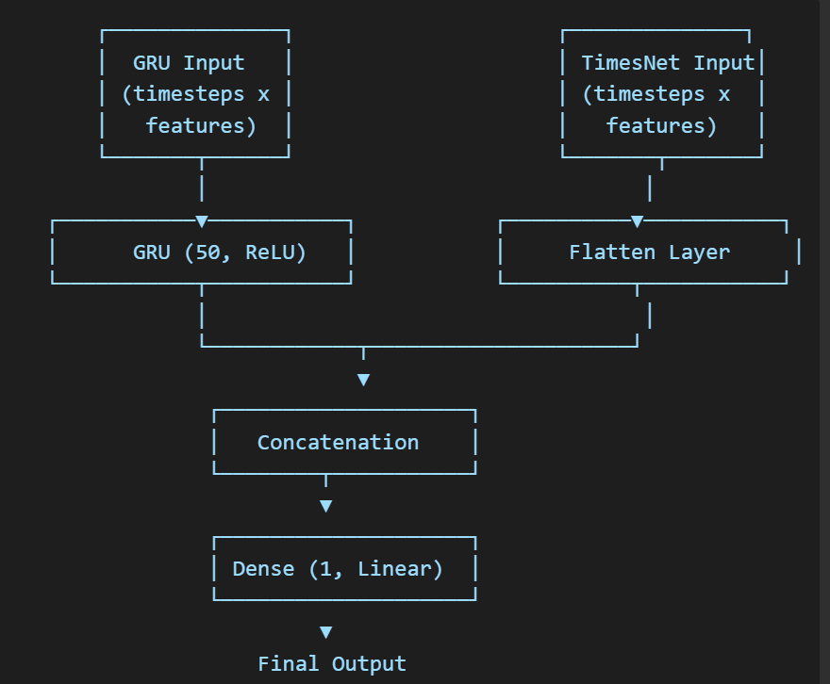
GRU + TIMESNET
GRU:
Handles sequential patterns and dependencies across time steps.
Outputs a compressed temporal representation.
TimesNet:
Focuses on learning relationships between features.
Outputs feature embeddings.
Integration:
Combines outputs from GRU and TimesNet for holistic learning.
Allows the model to learn both temporal and feature-specific dynamics.
Final Dense Layers:
Transforms the combined features into a single prediction for the target variable.
Fig : Working/Architecture of the model
GSoT, Computer Science & Engineering

Slide 22
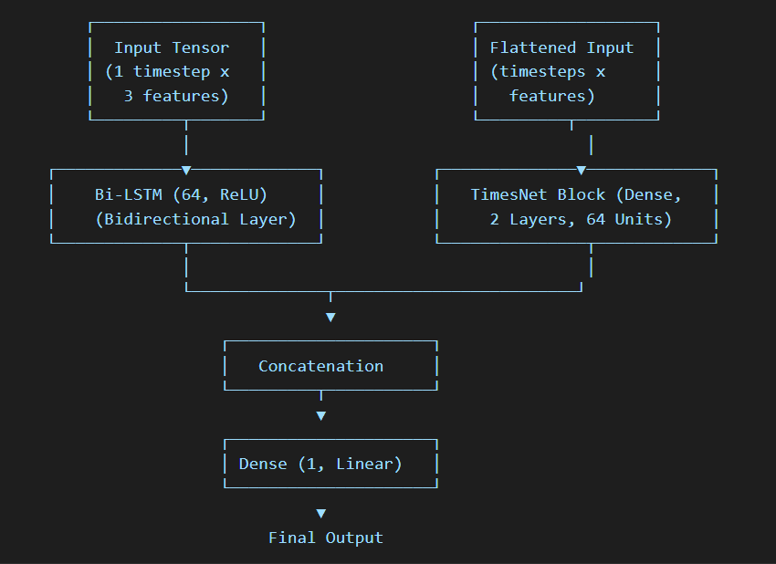
BI LSTM + TIMESNET
1. BiLSTM Branch
Handles Sequential Patterns:
Captures both past and future dependencies effectively, which is essential for sequential data like stock prices.
2. TimesNet Branch
Focus on Feature Relationships:
The TimesNet block captures feature-level dependencies using fully connected layers (Dense layers).
Processes the flattened input (ignoring temporal order) to extract high-dimensional feature embeddings.
3. Integration Layer
Merging Temporal and Feature Dynamics:
The outputs of the BiLSTM and TimesNet branches are concatenated to combine temporal and feature-specific insights.
4. Final Dense Layers
Prediction:
A fully connected Dense layer transforms the combined features into a single scalar prediction for the target variable (e.g., the closing price of a stock).
Fig : Working/Architecture of the model
GSoT, Computer Science & Engineering

Slide 23
MODEL PERFORMANCE
MODEL | MAE | MSE | RMSE | MAPE
CNN 1D | 1595.166 | 3251346.784 | 1803.149 | 1.8555
CNN 2D | 4795.0616 | 26595498.78 | 5157.0824 | 0.0552
CNN 3D | 1461.777 | 3466656.749 | 1861.896 | 1.7162
RNN | 8096.682617 | 67347192 | 8206.533495 | 9.356794506
LSTM | 416.4977292 | 340800.3986 | 583.7811222 | 0.4892616974
GRU | 397.408099 | 306645.694 | 553.7559878 | 0.4667090316
BI-LSTM | 380.599901 | 284154.2677 | 533.0612232 | 0.4468173881
Transformer | 85759.98959 | 7358908989 | 85784.08354 | 99.91529682
GNN | 27714.57227 | 773981696 | 27820.52652 | 32.25002587
ResNet | 7633.982422 | 59255288 | 7697.745644 | 8.877309412
GSoT, Computer Science & Engineering

Slide 24
Continued….
MODEL | MAE | MSE | RMSE | MAPE
ARIMA | 15,953 | 331024114.1 | 18194.068 | 18.604
SARIMA | 1579.235 | 4781679.57 | 2186.705 | 1.87
GARCH | 1236381.378 | 2167756545440 | 1472330.311 | 123603259.6
Exponential Smoothing | 50635.80787 | 2571024935 | 50705.27522 | 58.97303409
Prophet | 42244.67284 | 1791620621 | 42327.53974 | 49.2
TimesNet | 22276.50127 | 496755979.9 | 22288.02324 | 25.95059166
DeepAR | 2931.89899 | 13482604.07 | 3671.866565 | 3.409159372
CNN 3D + TimesNet | 2844.834344 | 8394004.208 | 2897.240792 | 3.319919793
TimesNet + GRU | 401.7646823 | 315859.1239 | 562.0134552 | 0.4725300889
TimesNet + Bi LSTM | 380.7761146 | 279526.0234 | 528.7022067 | 0.4463770718
GSoT, Computer Science & Engineering

Slide 25
PROPOSED MODEL : BI LSTM + TIMESNET
MAE
380.77
MSE
279526.02
The low MAE suggests that the average error (absolute deviation) between predicted and actual values is minimal, showing consistent performance across predictions.
The model's low MSE indicates that it avoids large deviations between predicted and actual stock prices better than other models.
RMSE
528.70
MAPE
0.446%
Its low RMSE confirms that large errors are effectively minimized.
This indicates that the model’s predictions are highly accurate relative to the scale of the data.
GSoT, Computer Science & Engineering

Slide 26
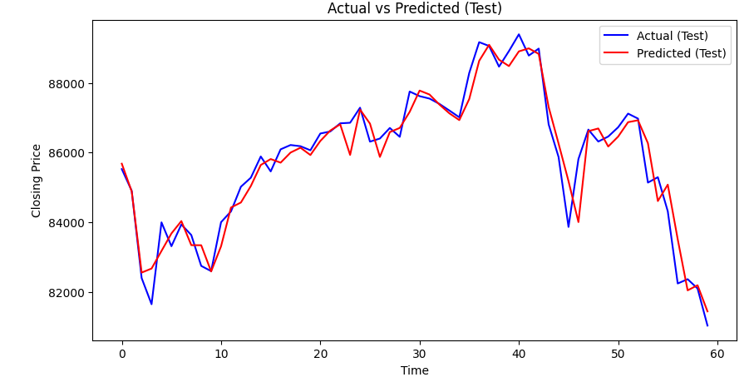
Fig : Actual vs Predicted values plot/ graphical representation
The TimesNet+BiLSTM model captures the general trend of the actual time series but exhibits limitations in predicting precise price levels and volatility, with a noticeable lag in predictions.
GSoT, Computer Science & Engineering

Slide 27
Bi LSTM BRANCH
TimesNet BRANCH
CONCATENATE
The input data (features Open, High, Low) is first processed by the Bi-LSTM layer. This layer captures the temporal dependencies from the time-series data.
The output of the Bi-LSTM layer is a vector (size 64), which represents the sequential information extracted from the input data.
After the Bi-LSTM, the same input data (the features Open, High, Low) is processed by the TimesNet block. This block is based on fully connected dense layers and is intended to capture features beyond what the Bi-LSTM layer might extract.
The output of the TimesNet block is also a vector (size 64), which represents different learned features from the same data.
The outputs of the Bi-LSTM (size 64) and TimesNet (size 64) are concatenated, resulting in a combined vector of size 128.
This concatenated vector is then passed to a Dense layer to generate the final output (the predicted closing price Close).
GSoT, Computer Science & Engineering

Slide 28
Import all the libraries
(Numpy,Pandas, Tensorflow, Keras, Sklearn, Matplotlib)
TimesNet Algorithm
(It takes an input tensor, applies 2 dense layers with ReLY activations)
Load Data
(Load both Training and Testing csv files into train_data and test_data DataFrames using pd.read_csv)
Data Cleaning
(Converts columns Close, Open, High, and Low into numeric values using pd.to_numeric(), handling any non-numeric entries by coercing them into NaN and drop rows with NaN values.)
Reshape Data for LSTM
(- The LSTM layer expects the data in a specific format: (samples, timesteps, features).
- Reshapes X_train, X_val, and X_test to have 1 timestep (since the data seems to be processed at a single timestep per input).)
Train-Test Split
(The training dataset is split into an 80% training and 20% validation set using train_test_split from sklearn.model_selection.)
Prepare Features and Target
(Features (X_train_full and X_test): Extracts the Open, High, and Low columns from the training and test datasets.
Target (y_train_full and y_test): Uses the Close column as the target variable.)
Define the Hybrid Model
(- Input layer: Defines input tensor
- Bi LSTM layer: A bi LSTM layer with 64 units
- TimesNet Block: Input is flattened and passed which returns processed vector
- Concatenation: Output of Bi LSTM and TimesNet concatenated into one combined tensor.
- Output Layer: Dense layer that outputs single value (predicted Close Value)
Compile the Model
(The model is compiled with Adam optimizer, which helps minimize loss during training and MSE loss function.)
Train the Model
(The model is trained using the fit() method, with 40 epochs and a batch size of 32.)
Make Predictions
(After training, predictions are made on both the validation and test datasets using model.predict().
Predictions for Test Set: pred_test contains the model's predictions for the test set.)

Slide 29
CHALLENGES
Not all models are designed for time-series data like stock prices and may not capture temporal dependencies effectively.
Evaluation Metrics Misalignment
Metrics like RMSE or MAPE can vary significantly across models depending on the nature of predictions (e.g., scale, bias towards larger values).
Model Suitability
Some models are sensitive to hyperparameter choices like learning rate, batch size, and number of layers.
Complex models might overfit the training data, resulting in poor generalization and high errors on the test set.
Hyperparameter Tuning
Overfitting
Stock market data often contains noise, non-stationarity, and sudden jumps (due to market events).
Implementing certain models like CNN 3D or Bi-LSTM might introduce errors due to improper data preprocessing or feature extraction.
Dataset Characteristics
Integration Issues
Some complex models require substantial data and training time and if trained on limited stock data or for a short time, they might underperform.
Model Architecture Adjustments
Some models may require architectural tweaks to better adapt to stock market data.
Training Duration
GSoT, Computer Science & Engineering

Slide 30
Thank You
GSoT, Computer Science & Engineering

